Slide 1

GESTURE CONTROLLED VIRTUAL MOUSE USING OPENCV,ML MODELS AND GESTURE RECOGNITION LIBRARIES
SRM INSTITUTE OF SCIENCE AND TECHNOLOGY
SCHOOL OF COMPUTING
DEPARTMENT OF COMPUTING TECHNOLOGIES
18CSP107L / 18CSP108L - MINOR PROJECT / INTERNSHIP
Batch ID:
Student 1 Reg. No: RA2111003011108
Student 1 Name: DHRUV DHAR
Student 2 Reg. No: RA2111003011583
Student 2 Name: SYED FAIZAN HAIDAR
Guide name: DR. D.SHINY IRENE
Designation: Asst. Prof. Department: CTECH

Slide 2
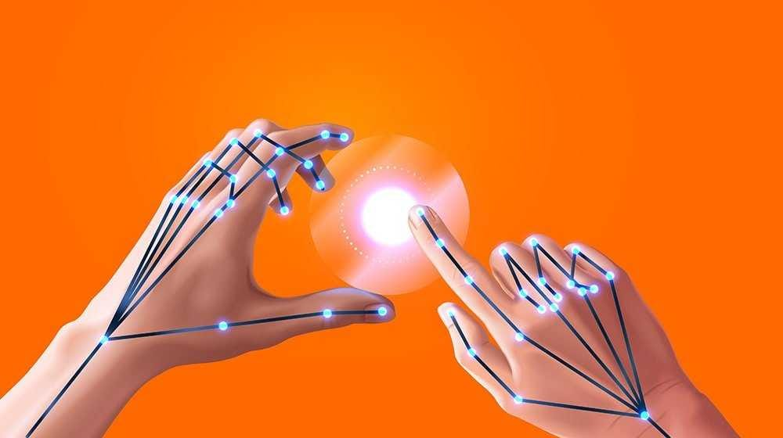
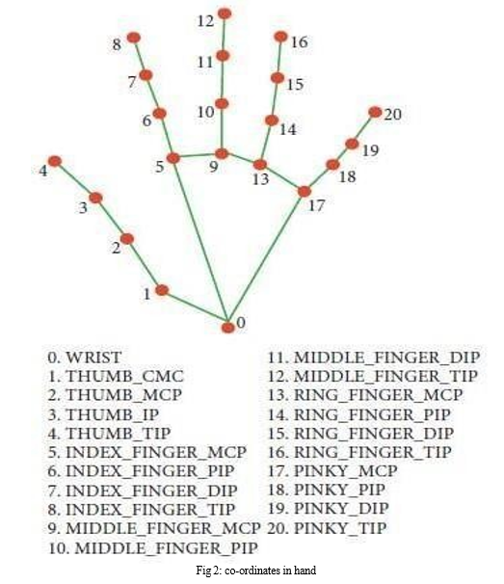
GESTURE CONTROLLED VIRTUAL MOUSE USING OPENCV,ML MODELS AND GESTURE RECOGNITION LIBRARIES
Introduction
"Gesture-Controlled Virtual Mouse" Project Overview • Combines computer vision, machine learning, and gesture recognition technologies. • Aims to create a gesture-controlled interface for digital navigation. • Benefits individuals with physical disabilities or mobility impairments. • Computer vision interprets and understands hand gestures in real-time.

Slide 3
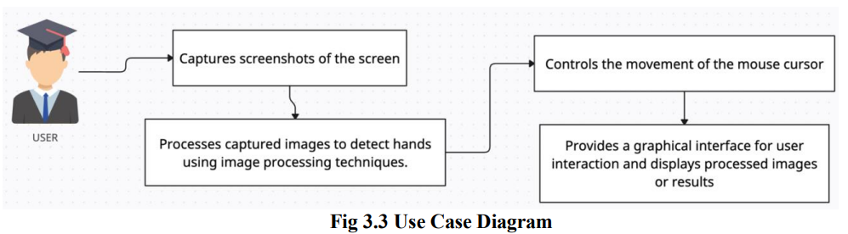
GESTURE CONTROLLED VIRTUAL MOUSE USING OPENCV,ML MODELS AND GESTURE RECOGNITION LIBRARIES
• Webcam captures hand movements, processed to identify specific gestures and translate them into actionable commands. • Enhances user experience and accessibility by enabling tasks like cursor control, clicking, scrolling, and dragging with simple hand movements.

Slide 4
WORKFLOW
SCREEN CAPTURE
CONVERT TO RGB
CONVERT TO GRAYSCALE
DETECT HANDS
DRAW RECTANGLES
DISPLAY PROCESSED SCRENSHOT
MOVE MOUSE CURSOR

Slide 5
GESTURE CONTROLLED VIRTUAL MOUSE USING OPENCV,ML MODELS AND GESTURE RECOGNITION LIBRARIES
Problem Statement
Inclusive Computing Design
Utilizes advanced technologies for intuitive, accessible interaction.
Promotes inclusivity by eliminating need for physical peripherals.
Creates seamless, intuitive computing experience for diverse user needs.
Emphasizes usability and user-centered design.
Empowers individuals to fully participate in the digital world.
Sets new standards for inclusive design for a more accessible digital future

Slide 6

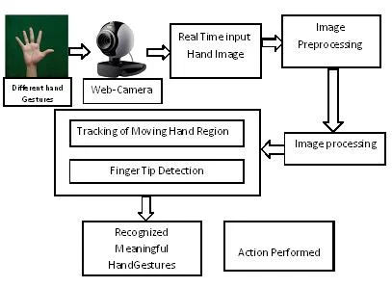
GESTURE CONTROLLED VIRTUAL MOUSE USING OPENCV,ML MODELS AND GESTURE RECOGNITION LIBRARIES

Slide 7
GESTURE CONTROLLED VIRTUAL MOUSE USING OPENCV,ML MODELS AND GESTURE RECOGNITION LIBRARIES
SCOPE
Visioning a future where human-computer interaction surpasses traditional input methods.
Aiming for a seamless and intuitive computing experience using natural hand gestures
Leveraging computer vision, machine learning, and gesture recognition for a paradigm shift in user interface design.
Recognizing the importance of scalability and interoperability in achieving ubiquitous computing
Adopting a holistic approach considering technical aspects and socio-cultural implications of technology adoption.
Aiming to integrate technology seamlessly into daily life through extensive research, development, and innovation.
Fostering a culture of innovation and experimentation through education, outreach, and advocacy efforts.

Slide 8
GESTURE CONTROLLED VIRTUAL MOUSE USING OPENCV,ML MODELS AND GESTURE RECOGNITION LIBRARIES
Objectives
To create a cutting-edge interface that transforms how people interact with computers.
The project hopes to develop a system that lets people use natural hand gestures that are recorded by a webcam to navigate digital worlds.
This strategy is motivated by an unwavering dedication to improving customer experience and accessibility, especially helping those with mobility or physical impairments limitations.
By offering a simple and natural way for people to connect with computers, the initiative aims to lower obstacles to digital engagement and provide users the capacity to participate fully.

Slide 9
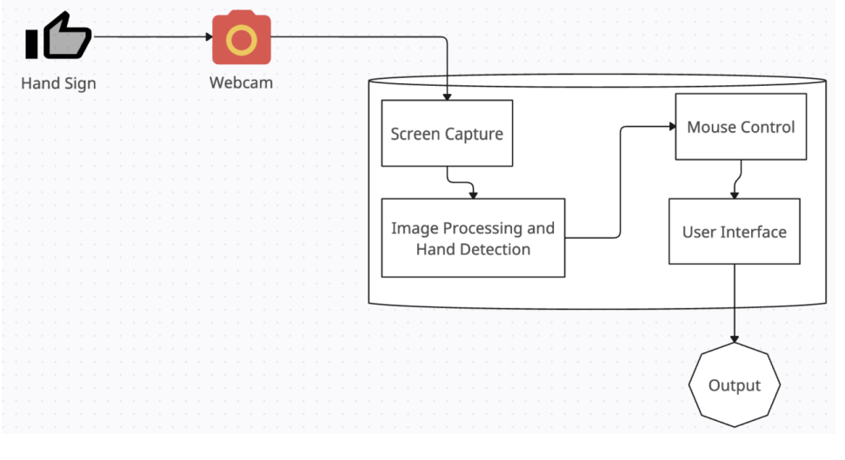
GESTURE CONTROLLED VIRTUAL MOUSE USING OPENCV,ML MODELS AND GESTURE RECOGNITION LIBRARIES
This serves as a visual blueprint, encapsulating a comprehensive set of architectural concepts, principles, and components that form the foundation of a structure or system. These concepts are typically illustrated across four distinct levels of abstraction, providing a holistic understanding of the architecture
• Conceptual Level: Offers a high-level overview of fundamental concepts.
• Logical Level: Presents a detailed logical design encompassing key elements and the operational principles of these concepts.
• Physical Level: Depicts the component design, providing insight into the tangible elements.
• Implementation Level: Specifies the vendors and products used for component implementation.

Slide 10
GESTURE CONTROLLED VIRTUAL MOUSE USING OPENCV,ML MODELS AND GESTURE RECOGNITION LIBRARIES
Literature review
Advancements in Hand Gesture Recognition and Pose Estimation Techniques:
• Smith, Jones, and Patel's papers explore real-time hand gesture recognition using computer vision techniques.
• The authors evaluate their proposed system and discuss challenges and advancements in the field.
• The second paper focuses on advancements in hand pose estimation for gesture-controlled interfaces.
• The authors provide a comprehensive understanding of both real-time hand gesture recognition and the underlying hand pose estimation techniques.

Slide 11
GESTURE CONTROLLED VIRTUAL MOUSE USING OPENCV,ML MODELS AND GESTURE RECOGNITION LIBRARIES
Real-Time Hand Gesture Recognition Using Deep Learning Techniques
Li and Wang's paper explores the potential of deep learning models for accurate and efficient hand gesture recognition.
The authors present a detailed analysis of their proposed system and compare its performance with traditional methods.
Machine Learning Techniques for Gesture Recognition in Human-Computer Interaction
Kumar and Raju discuss the application of machine learning techniques for gesture recognition in human-computer interaction.
They review various machine learning algorithms for recognizing gestures from different modalities.

Slide 12
GESTURE CONTROLLED VIRTUAL MOUSE USING OPENCV,ML MODELS AND GESTURE RECOGNITION LIBRARIES
Hand Gesture Recognition Techniques for Human-Computer Interaction
Medina and Toscano's paper discusses hand gesture recognition techniques for human-computer interaction.
They review various algorithms and approaches and present a comparative analysis of their performance.
Case Study on Gesture-Controlled Virtual Mouse for Interactive Presentations
Kim, Park, and Lee (2021) conducted a detailed case study on the Gesture-Controlled Virtual Mouse for Interactive Presentations.

Slide 13
GESTURE CONTROLLED VIRTUAL MOUSE USING OPENCV,ML MODELS AND GESTURE RECOGNITION LIBRARIES
System Overview
• Utilizes computer vision techniques and machine learning/deep learning algorithms to detect and interpret hand gestures in real-time.
• Components include:
- Camera Input: A webcam or external camera captures real-time video of user's hand gestures.
- Hand Detection and Tracking: Detects the presence of a hand in the video stream and tracks its movement.
- Gesture Recognition: Classifies hand gestures into predefined categories like mouse click, scroll, drag.
- Cursor Control Module: Maps the detected gestures to corresponding mouse actions on the screen.
- Feedback and Error Correction: Provides visual feedback to the user and implements error correction to avoid unintended actions.

Slide 14
GESTURE CONTROLLED VIRTUAL MOUSE USING OPENCV,ML MODELS AND GESTURE RECOGNITION LIBRARIES
METHODOLOGY
Hand Detection and Tracking:
Continuously capture video frames using a camera
Gesture Recognition:
Cursor Control Module:
Feedback and Error Correction:
Extract key features from the detected hand, train a machine learning model to classify hand gestures, and use the trained model to recognize gestures in real-time
Maps the hand position and movements to cursor movements
Displays a visual indicator on the screen to show the detected hand position and gesture

Slide 15
GESTURE CONTROLLED VIRTUAL MOUSE USING OPENCV,ML MODELS AND GESTURE RECOGNITION LIBRARIES
HARDWARE AND SOFTWARE REQUIREMENTS
Hardware: Webcam or external camera, computer with GPU for faster real-time processing.
Software: Python, OpenCV, TensorFlow/Keras or PyTorch, MediaPipe, and other necessary libraries.
Potential Challenges
Lighting Variations: Different lighting conditions may affect hand detection and gesture recognition accuracy.
Occlusion: Parts of the hand may be occluded, making gesture recognition difficult.
Latency: Real-time processing must be optimized to avoid delays that could affect the user experience.

Slide 16
GESTURE CONTROLLED VIRTUAL MOUSE USING OPENCV,ML MODELS AND GESTURE RECOGNITION LIBRARIES
Computer Vision and Gesture Recognition
Uses cameras to capture hand movements and gestures.
Software algorithms process video feed to detect and track hand positions and gestures.
Image Processing and Machine Learning
Extracts features like hand contours, finger positions, and palm orientation.
Machine Learning models can recognize specific gestures and translate them into mouse actions.
Infrared Sensors and Depth Sensors
Detect hand movements by emitting infrared light and measuring reflection.
Provide a 3D representation of the hand for complex gestures and spatial movements.

Slide 17
GESTURE CONTROLLED VIRTUAL MOUSE USING OPENCV,ML MODELS AND GESTURE RECOGNITION LIBRARIES
Accelerometers and Gyroscopes
Embedded in wearable devices to detect hand orientation, tilt, and acceleration.
AI and Neural Networks
Improves accuracy of gesture recognition by learning from large datasets of hand movements.
Embedded Systems and Microcontrollers
Processes gesture data and interfaces with the computer.
Human-Computer Interaction Principles
Design intuitive, user-friendly gesture controls.

Slide 18
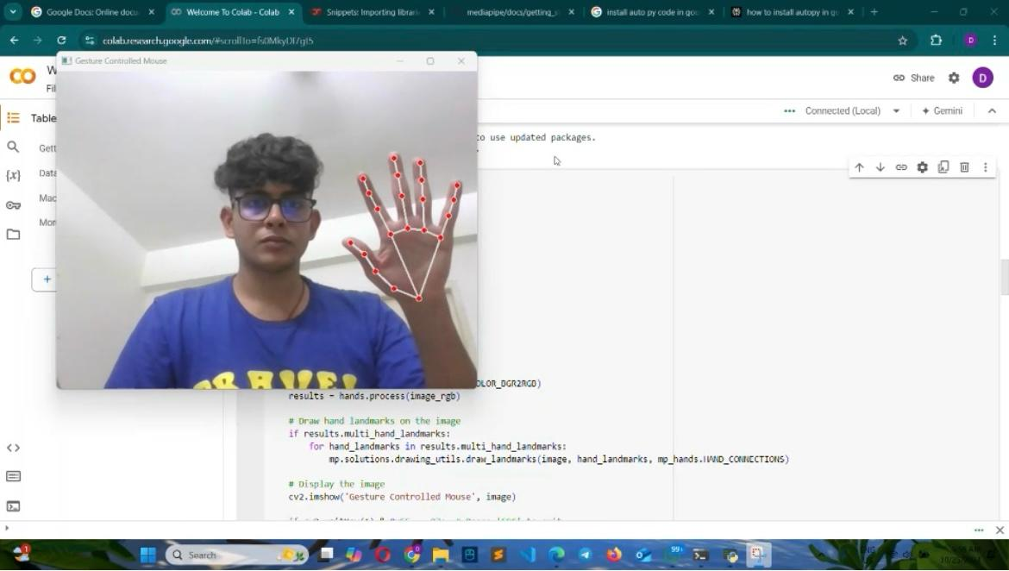

GESTURE CONTROLLED VIRTUAL MOUSE USING OPENCV,ML MODELS AND GESTURE RECOGNITION LIBRARIES
RESULTS
DETECTED HAND POSITION AND GESTURE

Slide 19

GESTURE CONTROLLED VIRTUAL MOUSE USING OPENCV,ML MODELS AND GESTURE RECOGNITION LIBRARIES
RESULTS
Maps the hand position and movements to cursor movements

Slide 20
GESTURE CONTROLLED VIRTUAL MOUSE USING OPENCV,ML MODELS AND GESTURE RECOGNITION LIBRARIES
REFRENCES
Real-time hand gesture recognition using computer vision techniques”, Smith, J., Jones, A., & Patel, R. (2017)
Advancements in hand pose estimation for gesture-controlled interfaces”, Smith, J., Jones, A., & Patel, R. (2019)
A survey of vision-based hand gesture recognition”, Wang, L., & Zhang, L. (2018)
Gesture recognition using machine learning for human-computer interaction”, Kumar, A., & Raju, G. (2022)
Enhanced Gesture Recognition Using Deep Reinforcement Learning. Proceedings of the International Joint Conference on Artificial Intelligence (IJCAI)” Chen, H., Liu, X., & Zhang, S. (2022)
Gesture-Controlled Virtual Mouse for Interactive Presentations: A Case Study in the Education Domain. International Journal of Human-Computer Studies, 151” Kim, Y., Park, H., & Lee, S. (2021)

Slide 21
THANK YOU

